Slide 1

A discussion of the changing nature of accounting and financial reporting
John Hepp
Partner
Professional Standards Group

Slide 2

Disclaimer
This presentation is not a comprehensive analysis of the subject matters covered and may include proposed guidance that is subject to change before it is issued in final form. All relevant facts and circumstances, including the pertinent authoritative literature, need to be considered to arrive at conclusions that comply with matters addressed in this presentation. The presentation is not intended to provide accounting or other advice or guidance with respect to the matters covered.
The views and interpretations expressed in the presentation are those of the presenter and not of Grant Thornton LLP.
All opinions
are strictly my own

Slide 3
Thomas Kuhn: The Structure of Scientific Revolutions (1962)
A paradigm is what members of a scientific community, and they alone, share
A paradigm shift is a change in the basic assumptions, or paradigms, within the ruling theory of science
Accounting and financial reporting
are in the middle of a
paradigm shift

Slide 4
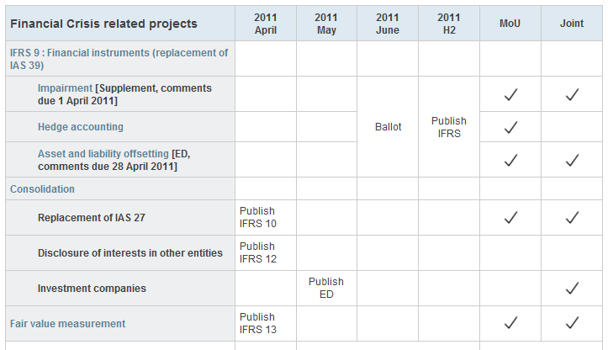
IFRS Agenda and the pace of change
Financial Crisis Projects

Slide 5
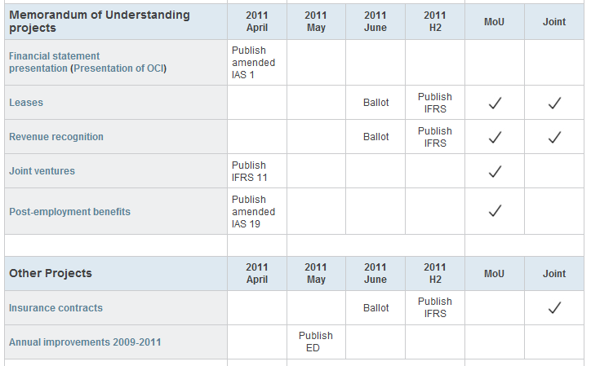
The convergence projects

Slide 6
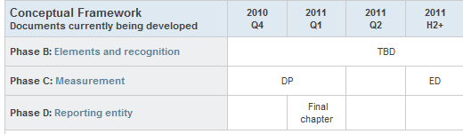
And a new conceptual framework… now running late

Slide 7
Deferred projects to be resumed later in 2011
Financial Statement Presentation
Financial Instruments with Characteristics of Equity
Emissions Trading Schemes
Liabilities
Income Taxes

Slide 8
Questionable support for a rapid pace of change
During 2011, the FASB and the IASB plan to issue standards that will include major revisions to the current accounting. How should these standards be implemented in the U.S.?
Item | Count | Percent %
Use an incremental approach where no more than one major standard takes effect in a given reporting year | 89 | 37%
The Boards should defer major changes in the financial reporting model until the projects have been more fully developed and field-tested | 66 | 27%
Use a “big bang” approach to improve the financial reporting model as quickly as possible | 48 | 20%
The standards should be implemented first in IFRS; U.S. companies can adopt the standards on adoption of IFRS | 40 | 16%

Slide 9




The Global Convergence Project
Convergence
US GAAP
IFRS

Slide 10
Convergence
The European View
Convergence
US GAAP
IFRS

Slide 11
Convergence
The American view
Convergence
US GAAP
IFRS

Slide 12
Or something else?
A new accounting model
US GAAP
IFRS

Slide 13
CFO survey results
Still looking for consensus
When should the U.S. adopt IFRS for public companies?
Item | Count | Percent %
After U.S. GAAP and IFRS have converged (5-7 years) | 136 | 49%
As soon as possible (2-5 years) | 72 | 26%
The U.S. should not adopt IFRS and focus on issuing high-quality standards | 45 | 16%
The U.S. should not adopt IFRS but have an ongoing goal of issuing converged standards | 24 | 9%

Slide 14
Dueling paradigms
The battle to define accounting

Slide 15
Dueling paradigms
The legal model: Financial reporting provides information about property rights and obligations of entities to creditors and owners and the results of past transactions
The finance model: Financial reporting provides information about future cash flows to allocate capital (set prices in capital markets)
Conflict between the two models has been described as "religious warfare"

Slide 16

A legal perspective:
General Purpose Financial Reporting
  A focus on the results of past transactions
    Transactions establish legal rights and
    obligations, enforceable at law
  A focus on stewardship and performance
    Income and return on investment
  And conservative measurement of income
    Recognize losses when incurred; income when realized
    Net income defined as the amount of resources that can safely be distributed from an entity whose owners have the privilege of limited legal liability

Slide 17
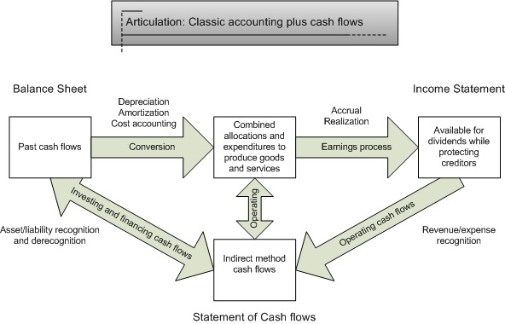
Mixed attribute accounting model
Motivation: accountability for assets, measurement of profit or loss

Slide 18

A finance perspective
Information for Investors and Creditors
  A focus on investors’ investment decisions
    Information for capital allocation
    Rational decisions in efficient markets
  A focus on future cash flows
    Valuation based on discounted future cash flows
    Amounts from past transactions are irrelevant
  Unbiased recognition
    Recognize gains and losses when estimable
    No need for a transaction, legal right or legal obligation

Slide 19
Cohesiveness and financial statement presentation
Proposed
Motivation: Accounting as forecasts of future cash flows

Slide 20
CFO survey results
Net income or comprehensive income?
Which of the following are considered to be primary
performance indicators by the users of your financial statements? (Select all that apply.)
Item | Count | Percent %
Cash flow from operations | 154 | 63%
EBITDA | 135 | 55%
Net income | 129 | 53%
Free cash flow | 84 | 34%
Earnings per share | 68 | 28%
Forward-looking financial information (i.e., forecasts) | 56 | 23%
Comprehensive income | 43 | 18%

Slide 21

Is double entry bookkeeping still relevant?
How should financial statements articulate?
What do we do with "undesirable" debits and credits?
  Other comprehensive income
  "Unrecognized" assets and liabilities
  Deferred costs and charges
  Prepaid expenses
  and unearned revenue

Slide 22

The objective of financial reporting

Slide 23

Objective of General Purpose Financial Reporting
A more traditional approach
The objective of financial statements is to provide information about the financial position, performance and changes in financial position of an entity that is useful to a wide range of users in making economic decisions.

Slide 24

CBRM
The primary objective of financial reporting is
“to provide all of the information that owners of common equity require to evaluate their investments. Common shareowners use this information to make forecasts of future cash flows, evaluate the sustainability of the company’s business model, and assess its cash-generating ability. This information, in turn, is used to estimate the investments’ value and future changes in such value.”
“Fair value information is the only information relevant for financial decision making”

Slide 25
The new framework
Conceptual Framework for Financial Reporting
September 2010
OB2. The objective of general purpose financial reporting is to provide financial information about the reporting entity that is useful to present and potential equity investors, lenders, and other creditors in making decisions about providing resources to the entity. Those decisions involve buying, selling, or holding equity and debt instruments and providing or settling loans and other forms of credit.
Original version referred to "making decisions in their capacity as capital providers."

Slide 26
Financial reporting provides information to help the reader prepare an assessment of future cash flows
OB3. Decisions by existing and potential investors about buying, selling, or holding equity and debt instruments depend on the returns that they expect from an investment in those instruments...Investors’, lenders’, and other creditors’ expectations about returns depend on their assessment of the amount, timing, and uncertainty of (the prospects for) future net cash inflows to the entity. Consequently, existing and potential investors, lenders, and other creditors need information to help them assess the prospects for future net cash inflows to an entity.

Slide 27

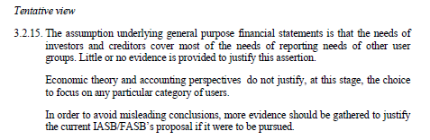
A minor problem

Slide 28
CFO survey results
Valuation or performance?
Which of the following describes the objective of financial reporting by your company?
Item | Count | Percent %
To provide information about past transactions and events so that users may evaluate your performance according to your business model and earnings | 141 | 58%
To provide information on economic resources, claims to those resources and changes to them so that users may estimate the nature, timing and risk of your future cash flows | 47 | 19%
None of the choices describe our objective for financial reporting. | 30 | 12%
To provide information about the nature, timing and risk of your future cash flows | 27 | 11%

Slide 29
CFO survey results
Owners or potential investors?
What is the primary reason that your firm prepares audited financial statements?
Item | Count | Percent %
To provide information on financial position and performance to owners of the firm | 97 | 40%
To meet other legal requirements | 45 | 18%
To obtain loans or other credit | 38 | 16%
To demonstrate compliance with loan covenants | 35 | 14%
To provide information useful for valuing equity and debt securities of the firm | 21 | 9%
Other | 9 | 4%

Slide 30
My view of the objective of financial reporting
Also found in paragraph 12 of the framework!
OB12. General purpose financial reports provide information about the financial position of a reporting entity, which is information about the entity’s economic resources and the claims against the reporting entity. Financial reports also provide information about the effects of transactions and other events that change a reporting entity’s economic resources and claims. Both types of information provide useful input for decisions about providing resources to an entity.

Slide 31
Qualitative characteristics
A complete rewrite
Changes the definition of qualitative characteristics
  From: desired qualities when making accounting choices
  To: the qualities that identify the types of information that are likely to be most useful to the existing and potential investors, lenders, and other creditors
Eliminates the equal status of relevance and reliability
Replaces reliability with representational faithfulness

Slide 32
Elemental differences

Slide 33
The fundamental element
OLD definition of an asset
  Assets are probable future economic benefits obtained or controlled by a particular entity as a result of past transactions or events.
Proposed NEW definition of an asset:
  An asset of an entity is a present economic resource to which the entity has a right or other access that others do not have.
What is an economic resource?

Slide 34
What is wrong with the old definition?
According to the staff…
Some users misinterpret the terms “expected” (IASB definition) and “probable” (FASB definition) to mean a high likelihood of future economic benefits; items with low likelihood would be excluded
Too much emphasis on identifying the future flow of economic benefits, instead of focusing on the item that presently exists
The definitions place undue emphasis on identifying the past transactions or events that gave rise to the asset
Interpret control in the same sense as that used for purposes of consolidation accounting
  The term should focus on whether the entity has some rights or privileged access to the economic resource

Slide 35
And the same with liabilities
Old definition of a liability
  Liabilities are probable future sacrifices of economic benefits arising from present obligations of a particular entity to transfer assets or provide services to other entities in the future as a result of past transactions or events
New proposed definition
  A liability of an entity is a present economic obligation for which the entity is the obligor
How does an economic obligation differ from a legal obligation?

Slide 36
Legal rights and obligations
Or estimated future cash flows?
When to recognize a cost: when incurred or when estimable?
  Lease accounting issues and contingencies bring this issue to the forefront
When to recognize an asset: when earned or when estimable?
  One of the core issues of fair value accounting

Slide 37
My own views
Multiple elements
The definition of an asset is flawed
Cash in the currency of account is a separate element
Must be based on rights at law (from a past transaction)
Goodwill is a separate type of asset
  Estimated future cash flows
  Different unit of account
Government actions that create legal rights such as patents, copyrights and quotas are also transactions

Slide 38

Executory contracts

Slide 39
Executory contracts
The US SEC identifies the options
Recognize all contractual rights and obligations as assets and liabilities.
Do not recognize contractual rights and obligations as assets and liabilities.
View the contractual rights and obligations within a particular contract as a group, and recognize the group as an asset or liability.
Standard setters traditionally have selected the second option

Slide 40
CFA Institute prefers the first option
…that all activities that currently are off balance sheet as a result of accounting standards or other conventions must be recognized, including executory contracts. Executory contracts, arrangements for which performance by the various parties is still in progress, represent commitments entered into by the parties. These commitments will affect shareowners’ wealth and should be recognized as any other obligation would be.

Slide 41
The asset and liability approach to standard setting
In the asset/liability view, the standard setter .. would, first, attempt to define and specify the measurement for the assets and liabilities that arise from a class of transactions. The determination of income would then be based on changes in the assets and liabilities so defined
Executory contracts and the asset/liability approach will be key to determining the accounting for revenue recognition and leases.

Slide 42

A conceptual framework for fair value

Slide 43
Fair value is somewhat misleading
Fair Value: The price that would be received to sell an asset or paid to transfer a liability in an orderly transaction between market participants at the measurement date
  Fair value equals exit value
Principle: In all instances, the reporting entity shall maximize the use of relevant observable inputs and minimize the use of unobservable inputs.
  Level I = market value (Max: Observable, Unobservable = 0)
  Level II = equivalent market value (Observable > Unobservable)
  Level III = hypothetical market value (Unobservable > Observable)

Slide 44
Assumptions matter
“Indeed, in the context of completely frictionless markets, where assets trade in fully liquid markets and there are no problems of perverse incentives, accounting would be irrelevant since reliable market prices would be readily available to all.”
In the real world, there are transaction costs:
  Search and information costs
  Bargaining costs (how much is this worth)
  Policing and enforcement costs (making sure the other party sticks to the terms of the contract)

Slide 45
What is market value?
Is fair value the intrinsic value of the asset or liability?
In fair value accounting, an observable value in an active market is equal to underlying value:
          Error = zero
In my opinion this is not correct. Market values, even values from an active market, are only an estimate of an unknown underlying value:
  V= (v + e)
  Where V is an estimate of the underlying value v
  plus an error term e whose expected error is zero
  (and normally distributed)

Slide 46
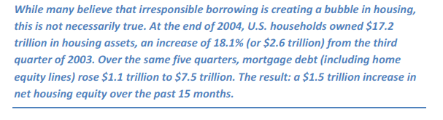
Is fair value equal to intrinsic value?
Case study: US Housing Markets
"Mr. Greenspan's Cappuccino" Commentary by
Brian S. Wesbury, Wall Street Journal, May 31, 2005.

Slide 47
Market value may not always be relevant and may lead to pro-cyclicality
If the purpose of the exercise is to assess the soundness of the aggregate household sector balance sheet, then the marked-to-market value of the total US housing stock (assessed at the current marginal transaction price) may not be a good indicator of the soundness of the aggregate balance sheet. Instead, it would be better to ask how much value can be realized if a substantial proportion of the housing stock were to be put up for sale. The value realized in such a sale would be much smaller than the current marked-to-market value. This is one instance in which marking to market gives a misleading indicator of the aggregate position.
"Fair Value Accounting and Financial Stability" by Guillaume Plantin. Haresh Sapra and Hyun Song Shin (2008)

Slide 48
Financial Instruments
Never let a crisis go to waste

Slide 49
Two different models for financial instruments
FASB
  Fair value with limited exceptions
IASB
  Amortized cost with a limited fair value option

Slide 50

FASB visited by a Christmas spirit
The FASB proposal drew heated criticism, including
more than 2,800 comment letters and
passionate remarks at a series of roundtables
Just before breaking for the Christmas holiday,
all five members of the board said that they are
"open to considering" other measurement approaches
for certain financial assets
The FASB tentatively agreed on January 25, 2011,
to revise its approach to classifying and measuring financial assets by narrowing the circumstances under which financial assets would be subject to fair value accounting

Slide 51
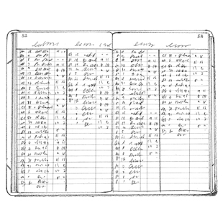
Audit implications
The changes to the FASB proposal to use fair value for all loans is an improvement
We do not believe the proposed impairment model is implementable
Measurement will be more labor intensive
Auditing will be more labor intensive
The financial statements will be
more difficult to understand

Slide 52
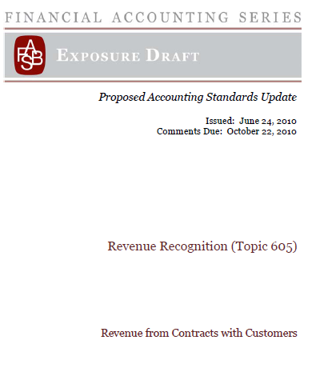
Revenue Recognition

Slide 53
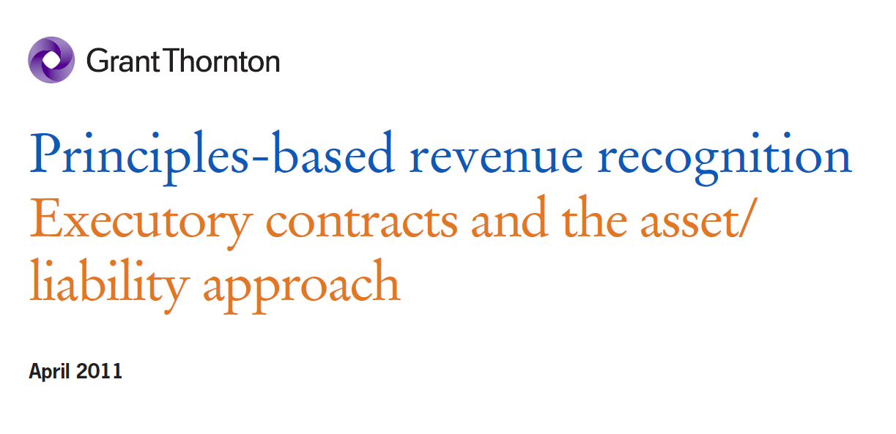
Revenue Recognition
Issues
Executory contracts
  When do you recognize the assets and liabilities arising from a sales contract?
Asset/liability approach
  Is control over a service operational?

Slide 54
Example 29 from the ED
January 1 A vendor enters into a contract with the customer for $1,000
March 31 The vendor transfers control of the product to the customer
April 30 The customer pays the vendor

Slide 55
Example 29 from the ED
January 1, contract inception
  No entry
March 31, control transferred
  Dr. Receivable $1,000
Cr. Revenue $1,000
April 30, payment received
Dr. Cash $1,000
Cr. Receivable $1,000
From the journal entries provided in the ED, it is not observable how or when the performance obligation was created or satisfied and therefore, it is not observable how revenue was generated.

Slide 56
Recording the executory contract
January 1, contract inception
Dr. Contract asset (memo) $1,000
Cr. Performance obligation (memo) $1,000
March 31, control transferred
Dr. Receivable $1,000
Cr. Contract asset (memo) $1,000
Dr. Performance obligation (memo) $1,000
Cr. Revenue $1,000
The performance obligation is satisfied and revenue is recognized

Slide 57
A change in accounting principle
Revenue recognition = Satisfaction of a performance obligation
The initial principle…
Satisfaction of a
performance obligation = Transfer of a good or service to a customer
is transformed…
Transfer of a good or
service to a customer = Customer obtains control of a good or service
to a different principle
Revenue recognition = Customer obtains control of a good or service

Slide 58
Cross cutting issues
A model that focuses on derecognition of the performance obligation instead of transfer of control may prove to be more understandable to both preparers and readers of the financial statements
The issue of executory contracts extends beyond revenue recognition
  The accounting for purchases
  The accounting for leases

Slide 59
A private conceptual framework:
Revenue recognition
Paragraph 5
5. The objective of the proposed guidance is to establish the principles that an entity shall apply to report useful information to users of its financial statements about the amount, timing, and uncertainty of revenue and cash flows arising from a contract with a customer.
Question 10 - The objective of the Boards’ proposed disclosure requirements is to help users of financial statements understand the amount, timing, and uncertainty of revenue and cash flows arising from contracts with customers. Do you think the proposed disclosure requirements will meet that objective? If not, why?

Slide 60
Our response
We think the proposed disclosure objective is inconsistent with The Conceptual Framework for Financial Reporting 2010. That document (at OB3 for example) explains that the users of financial statements make an assessment of prospects for future net cash inflows to an entity.
The proposed objectives in paragraph 5 and in paragraph 69 could be viewed as shifting responsibility from the user to the reporting entity to make the assessment of the amount, timing and uncertainty of future cash flows.

Slide 61
Audit issues
More focus on contracts than shipping or billing documents
Allocation of revenue to multiple element contracts
Onerous contracts

Slide 62

Lease Accounting:
A Whole New Ballgame

Slide 63
Scope: When is a lease a sale, a partial sale, or an executory contract?
Boundary determined by control at the end of the lease term
Boundary for distinct services
Sale of a good
Derecognition approach
(partial sale)
Performance
obligation
(lease)
Performance obligation (service)
Revenue recognition
standard
Lease accounting
standard
Revenue recognition
standard
The Boards have not redeliberated this model but are likely to
make changes based on decisions made about lessee accounting
Notes:
Both lessors and lessees would be required to evaluate whether the lease payments should be allocated between service and lease components, considering all concurrently negotiated contracts with a third party.
A lessor would be subject to the revenue recognition requirements regarding the identification of separate performance obligations within an arrangement. That is, if the service component is not considered distinct, total payments under the arrangement should be accounted for as the lease. If the service component is considered distinct, total payments under the arrangement should be allocated between the service and lease components using the same principles as those proposed in the revenue recognition project.
The lessee’s identification of distinct components within an arrangement and measurement of the allocation between distinct service and lease components within an arrangement would be based on the same principles used by the lessor. The Boards noted that if the proposed revenue recognition guidance is incorporated into the proposed new leases guidance, some language changes would be necessary.
If the lessor or lessee is unable to allocate the total payments among the service and lease components of an arrangement, the entire arrangement should be considered and accounted for as a lease.
If the total payments under an arrangement that contains both lease and service components change after the inception of the lease (for example, term options or contingent rentals), an entity would first determine whether the entire change is directly attributable to either the lease or the service component. If it is unable to do so, then the change in total consideration should be allocated on a pro rata basis to the various contract components in the same proportion as determined at contract inception.

Slide 64
The "right of use" asset model
Boundary determined by control at the end of the lease term
Boundary for distinct services
Purchase of a good
Right-of-use asset
Purchase of a service
IAS 16 or ASC 360
Property, Plant
and Equipment
Lease accounting
standard
Executory contract
no recognition
The original model as presented in the Exposure Draft
Notes:
Both lessors and lessees would be required to evaluate whether the lease payments should be allocated between service and lease components, considering all concurrently negotiated contracts with a third party.
A lessor would be subject to the revenue recognition requirements regarding the identification of separate performance obligations within an arrangement. That is, if the service component is not considered distinct, total payments under the arrangement should be accounted for as the lease. If the service component is considered distinct, total payments under the arrangement should be allocated between the service and lease components using the same principles as those proposed in the revenue recognition project.
The lessee’s identification of distinct components within an arrangement and measurement of the allocation between distinct service and lease components within an arrangement would be based on the same principles used by the lessor. The Boards noted that if the proposed revenue recognition guidance is incorporated into the proposed new leases guidance, some language changes would be necessary.
If the lessor or lessee is unable to allocate the total payments among the service and lease components of an arrangement, the entire arrangement should be considered and accounted for as a lease.
If the total payments under an arrangement that contains both lease and service components change after the inception of the lease (for example, term options or contingent rentals), an entity would first determine whether the entire change is directly attributable to either the lease or the service component. If it is unable to do so, then the change in total consideration should be allocated on a pro rata basis to the various contract components in the same proportion as determined at contract inception.

Slide 65
The right of use asset model is breaking down
Boundary to be determined
Boundary for distinct services from Revenue Recognition
Financing
Lease
Other leases
Purchase of a service
Right of use asset,
amortized liability
Straight-line recognition?
Executory contract
no recognition
Notes:
Both lessors and lessees would be required to evaluate whether the lease payments should be allocated between service and lease components, considering all concurrently negotiated contracts with a third party.
A lessor would be subject to the revenue recognition requirements regarding the identification of separate performance obligations within an arrangement. That is, if the service component is not considered distinct, total payments under the arrangement should be accounted for as the lease. If the service component is considered distinct, total payments under the arrangement should be allocated between the service and lease components using the same principles as those proposed in the revenue recognition project.
The lessee’s identification of distinct components within an arrangement and measurement of the allocation between distinct service and lease components within an arrangement would be based on the same principles used by the lessor. The Boards noted that if the proposed revenue recognition guidance is incorporated into the proposed new leases guidance, some language changes would be necessary.
If the lessor or lessee is unable to allocate the total payments among the service and lease components of an arrangement, the entire arrangement should be considered and accounted for as a lease.
If the total payments under an arrangement that contains both lease and service components change after the inception of the lease (for example, term options or contingent rentals), an entity would first determine whether the entire change is directly attributable to either the lease or the service component. If it is unable to do so, then the change in total consideration should be allocated on a pro rata basis to the various contract components in the same proportion as determined at contract inception.

Slide 66

Leases
Example – lessee accounting
5 year lease of office space with 5 year renewal at market
Initial monthly rent of $100,000
Rent increases by 2% each year
Lessee's incremental borrowing rate is 9%

Slide 67
Income statement
Frontloading of expense for lessees, revenue for lessors

Slide 68
Other audit issues
How to distinguish between a lease and a service contract
Accounting for multiple element lease contracts
How to measure an impaired right of use asset
Determining the lease term
Measuring contingent rents

Slide 69

Conclusion

Slide 70


More than a cosmetic change
“The intellectualization of financial reporting in the shadow of financial economics is not just a matter of technical measurement – it is a blueprint for redesigning the knowledge base of an entire profession.”
  Michael Power, Professor of Accounting, London School of Economics and Political Science
Previous core competencies based on accounting conventions are being replaced by valuation techniques.
Preparing, auditing, and understanding fair value
measurements a whole new set of skills

Slide 71

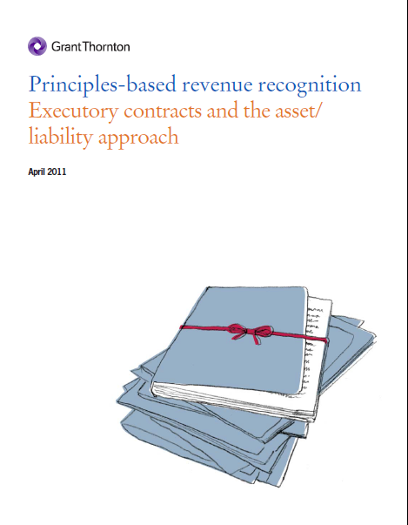
Some additional reading

Slide 72

Questions or comments?

