Slide 1
THE IMPORTANCE OF A BRAND AND BRANDING
Martin van Roekel
CEO BDO International
February 2012

Slide 2
THE IMPORTANCE OF A BRAND

Slide 3




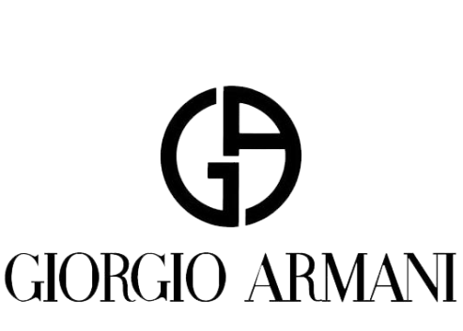

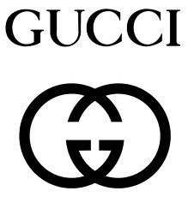
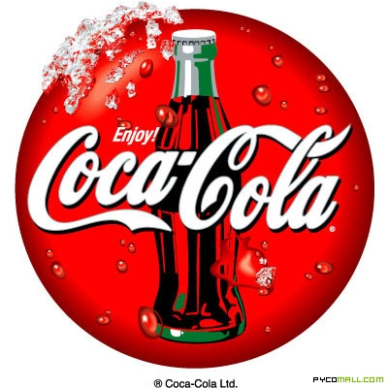

WHAT IS A BRAND?

Slide 4
WHY IS A BRAND IMPORTANT?
The power to change client response
The power to contribute to building a successful business:
      Increasing market share
      Reducing risk and sales costs
      Creating higher margins
A strong brand means greater client engagement
Greater client engagement means more work and more revenue
Replace the word ‘brand’ with ‘reputation’ ...
Notes:
But brands are just as relevant in the business to business world - be it Accenture, PWC, Deloite or any other B to B brand
they too encourage trial, command a premium, build preference and engender loyalty
And by changing customer or client behaviour in this way - contribute to building a successful business through
Increased market share
Reduced risk
Reduced cost of sales
Higher margins
If you are in any doubt that brands are key in the business to business world then replace the word ‘brand’ with ‘reputation’.
Replace the word ‘brand’ with ‘reputation’ and we can see why both client expectations and competitor performance are rising

Slide 5
WHY IS BRANDING SO HOT?
People have (too) many choices and too little time
Most offering have similar quality and features
We tend to base our buying on trust
Trust comes from meeting and beating customer expectations

Slide 6
WHAT IS A BRAND?
  Not just a logo
  It is not an identity, not a product
  A promise
  The delivery of that promise forms a bond
  People will select the brand with which they have a bond
  Trust is built up over time and the client will continue to turn to the brand with which they have a bond
Notes:
A brand is not just a logo, it is a mix of the rational and the emotional sides of our brain
A brand is both a promise, and the delivery of that promise: as such, it forms a bond with us
The emotional bond with the brand builds preference: businessmen and women have choices – but they are more likely to select the brand with which they have a bond
Brands engender loyalty - if a client has a bond with a BDO partner, trust is built up over time and they are more likely to continue to turn to BDO for advice

Slide 7
WHAT IS A BRAND?
  A complex entity that exists in the mind of a client
  Not what WE think it is, but what CLIENTS think it is
  It is not what YOU say it is, it’s what THEY say it is
  It’s a person’s gut feeling about a product, service or organisation
  It’s the sum of all our touch points with our clients
  Above all, CONSISTENT

Slide 8
WHAT IS BRAND CONSISTENCY?
  The word “consistent” means “harmonious uniformity or agreement among things or parts”
  Brand consistency means having agreement on how the brand is represented
  Brand consistency means representing the brand in the same way wherever in the world
  This requires discipline, understanding and agreement

Slide 9
WHY IS BRAND CONSISTENCY IMPORTANT?
  Inconsistent brand implies inconsistent products / services?
  Clients expect a consistent experience – domestic and international
  To protect the (international) client base
  Client expectations and competitor performance are rising
  Consistency creates efficiencies

Slide 10

WHY IS CONSISTENCY IMPORTANT?
Trial
An excellent and memorable experience in Singapore, say
The same brand will be chosen over unknown brands in Hong Kong
Notes:
Brand encourages trial.
If you have an excellent and memorable experience at the Oriental Hotel in say Singapore,
when you next travel to Hong Kong it is very likely that you would choose the Oriental in preference to a unknown hotel on the assumption that the values and standards that made the Oriental Singapore excellent will hold good for others in the chain.

Slide 11

WHY IS CONSISTENCY IMPORTANT?
Emotional bond
In blind tastings, Pepsi is preferred to Coca Cola
Coca Cola out sells Pepsi by a long way
Notes:
It is the emotional bond with the brand that builds preference.
Both consumers and businessmen have choices – but they are more likely to select the brand with which they have a bond.
It is commonly accepted that in blind tastings Pepsi is preferred to Coca Cola, yet Coca Coal out sells Pepsi Cola by a long way
How can this be explained except in terms of Coke having a more compelling brand?

Slide 12
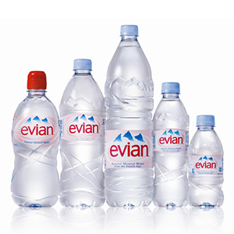
WHY IS IT IMPORTANT?
Premium
People care what other people think
Bottled water is all about brands
          Premium car brands realise much higher margins
Notes:
Brands also command a premium.
Many people are prepared to pay more for Levi jeans than for a pair from the local supermarket even if there is parity in quality and fit.
In short they care enough about what other people think to make sure they have the right label.
Arguably the entire business of bottled water is based on the power of brands as in reality there are few discernable difference between any of the products…

Slide 13
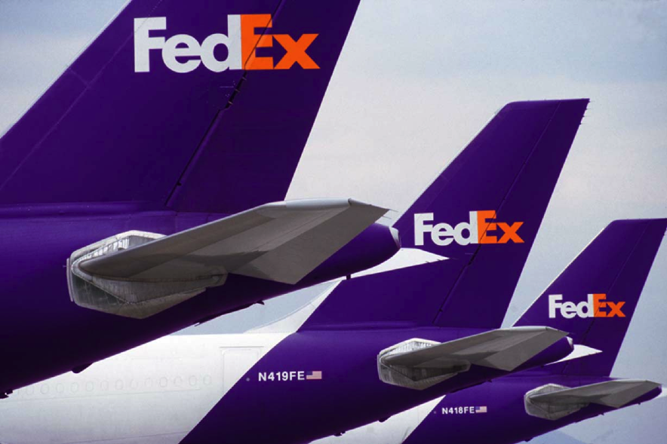
WHY IS IT IMPORTANT?
Loyalty
If you have trust in a brand, you are more likely to be forgiving when something goes wrong
Notes:
Lastly brands engender loyalty - if one of your clients has a bond with you as a BDO Partner, he is likely to be more forgiving in the event of something going wrong.
If you have a good image of FedEx and they let you down one day, they will have built enough trust over time such that you will continue to use them.

Slide 14
BUILDING A BRAND
Differentiate
Collaborate
Innovate
Validate
Cultivate
To be followed by :
a continuing brand education program

Slide 15

BUILDING A BRAND
Differentiate
Our brains act as filters to protect us from too much information
We are hardwired to notice only what is different
SO YOU HAVE TO BE DIFFERENT

Slide 16

BUILDING A BRAND
Differentiate
People join different tribes for different activities
    Driving ->Volkswagen
    computing -> Lenovo
    sports -> Nike
To differentiate:
FOCUS, FOCUS AND FOCUS
Focus test: Who you are - is this how your clients see you?

Slide 17
BUILDING A BRAND
Collaborate
  Building a brand is a collaborative project
  3 basic models to develop and steward the brand:
    One-stop shop provider
    Hire best-of-breed specialists
    Integrated process managed internally:
    open cooperation with best-of-breed specialists
  It will not be simple

Slide 18
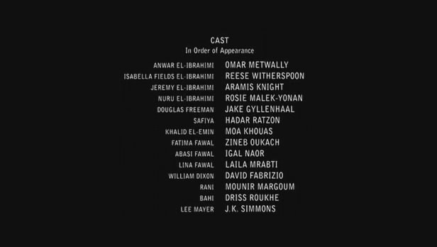
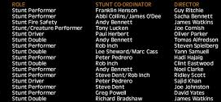

BUILDING A BRAND
Collaborate
  Hollywood is an example of a successful model – making a movie takes hundreds of collaborators

Slide 19
BUILDING A BRAND
Innovate
Creativity is what gives brands the traction in the marketplace
Strategic thinking <-> creative thinking
The brand needs a stand-out name
Distinctive | Appropriate
Brief | Likeable
Easy to say | Easy to spell
Extendable | Protectable

Slide 20
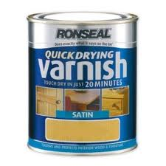
BUILDING A BRAND
Innovate
For retail products,
package is extremely important
For web sites, it is important to be
user friendly and accessible
“Does exactly
what it says
on the tin”

Slide 21
BUILDING A BRAND
Validate
Bring the validation audience into the process
Don’t use large quantitative studies or focus groups
Better a right answer to a rough question than a detailed answer to the wrong question
Do cheap-quick-dirty tests to measure
Distinctiveness | Relevance
Memorability | Extendibility
Depth of meaning

Slide 22

BUILDING A BRAND
Cultivate
Business is a process, not an entity
A living brand is a pattern of behaviour, not a stylistic veneer
Old paradigm: control the look and feel of a brand
New paradigm: influence the character of a brand
If a brand looks like a duck and
swims like a dog,
people will not trust it

Slide 23
BDO – a short introduction

Slide 24
BDO WORLDWIDE as at 30 September 2011
Fee income: €4.1 / $5.7 billion
Partners and staff: 48,767
Offices: 1,118
Countries: 135
Member firms: 101
BDO is the market leader for exceptional client service

Slide 25
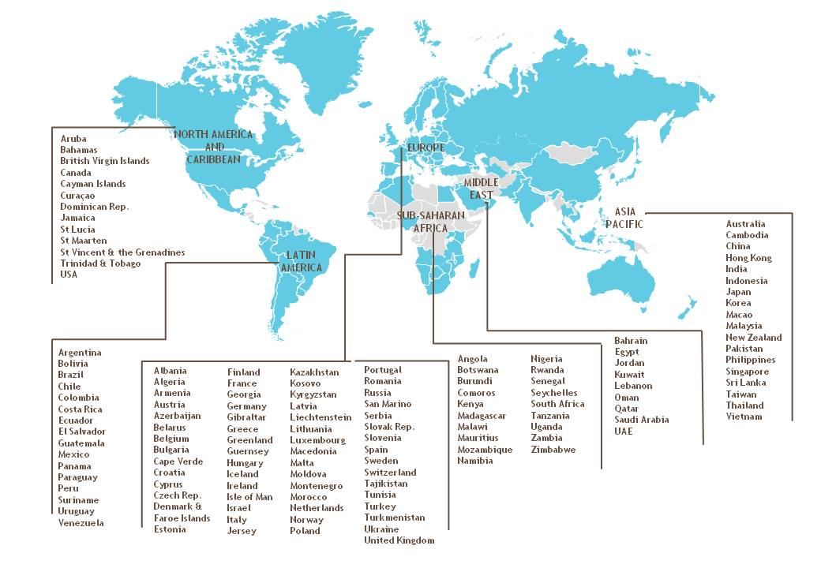
OUR REGIONS at 30 September 2011

Slide 26
GLOBAL GROWTH
Revenue

Slide 27
REVENUE
2011 fees by discipline

Slide 28

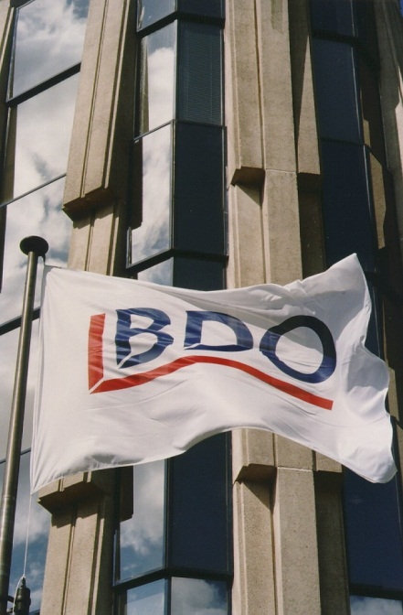
OUR BRAND
BDO’s strong brand is based upon
a worldwide reputation for exceptional service
delivered by
exceptional people

Slide 29
CREATING THE STRONG BDO BRAND

Slide 30
THE BDO BRAND
Who are we?
Just to be known is not enough
We need to be known for something
      Exceptional service
      Delivered by exceptional people
  All BDO firms share in our international reputation worldwide as the market leader for exceptional client service

Slide 31
THE BDO BRAND
Developing brand strategy
Different
Relevant
Credible
Sustainable
Competitors
Clients
BDO
Future
Notes:
1st - we needed a brand strategy which was, differentiated, relevant, credible and sustainable -
different from our competitors –
relevant to our customers –
credible to us and
sustainable over time

Slide 32
THE BDO BRAND
How we developed our positioning
  Independent external market research
    We scored highly in the area of ‘client relationship’s
    But member firms were not focussing on ‘relationships’
  Workshops to obtain internal views and input
  Conclusion:
    To move ahead of the mid-tier firms
    To not seek to be another ‘Big 4’
Notes:
Therefore we needed to get a firm base of information and understanding upon which to start
We did this by carrying out relevant research.
Research was key - desk research, market research and interviewing analysts, recruiters, clients - and you, both Partners and employees.
It is hugely important that the process of brand strategy development involved as many BDO people as possible, and we made great efforts to make it so.

Slide 33

WHAT MAKES A SUCCESSFUL BRAND?
Relevant differentiation
  We build differentiation
  by maximising the distance between us and our competitors
  We increase our relevance to our clients
  by minimising the distance between us and them
  Relevant differentiation is the key to brand success
Notes:
Our brand strategy is based on 3 elements:
BDO, our competitors, our clients
But at the heart of a successful brand strategy is the simple idea of maximising the distance between us and our competitors, i.e. building differentiation,
and at the same time minimising the distance between us and our clients i.e. increasing our relevance to them.
Relevance is a key driver of revenue - but differentiation is a significantly stronger driver of revenue
When BDO’s relevance and differentiation are significantly increased, our revenue growth is strongest
That is, successful brand strategy is all about relevant differentiation.

Slide 34

WHY DO WE NEED A GLOBAL BRAND?
  Market expectations
  Recruitment and retention
  Voices from the network
  To grow
Notes:
We need a global brand for a number of reasons
Firstly strategic market requirements - what our customer and especially our larger customers are asking us to be and do
Secondly to recruit and retain the best people
Thirdly voices from the network - What BDO Partners and employees are telling us they want from BDO
And ultimately to grow

Slide 35
WHY DO WE NEED A GLOBAL BRAND?
Market expectations
Global presence and coherence
Consistent service delivery world wide
Global reputation
Greater local opportunity
Notes:
FRANS
Because of market expectations. Continually developing and becoming more demanding – you don’t need telling…
All clients, multinational in particular, expect their accounting firms – indeed all their advisers - to have not only a global presence, but a coherent global image and reputation
They also expect consistent service delivery - world wide basis, not just locally
AND, nowadays, we even have to demonstrate a global reputation if we are to make the best of our local opportunities. The global brand will open doors locally. Secondly….

Slide 36

WHY DO WE NEED A GLOBAL BRAND?
Recruitment and retention
Maximising our appeal to the best graduates and potential employees
Giving them a more fulfilling work life
Growing our people
Notes:
FRANS
Recruitment issues. A global brand without doubt helps to build a better working environment – accountancy business is about 3 things: people, people and people.
In fact, no professional services organisation can hope to thrive without attracting and keeping the most able people in the market place.
Recruitment and retention therefore has to be one of our strategic objectives, and a global brand will attract talented employees – the sort who take pride in their work, are passionate about it.
A strong brand also encourages individuals to develop their skills and careers – which will grow and stretch the business – and ultimately fulfil their needs, and those of their clients.

Slide 37
WHY DO WE NEED A GLOBAL BRAND?
Our firms want to grow
To increase our referrals
To get local work from multinational clients
To improve our overall share of international work
Notes:
BDO’s Partners and employees want a stronger global brand.
Throughout all our research everybody canvassed wanted to work for an accountancy network with a stronger international reputation.
Finally, and most obviously…
A global brand can help us grow.
Since 2004 our international referrals have grown from 5% to ??
And a global brand can help us obtain more international and trans-national work from existing clients - improving our overall share of our international clients’ business.

Slide 38
CONSISTENT BRANDING
Across the world
Our brand gives us a common identity
Our brand gives us a consistent way to engage with clients
Our brand reflects our clients’ expectations:
      a consistent international experience that is
      as good as their domestic experience

Slide 39
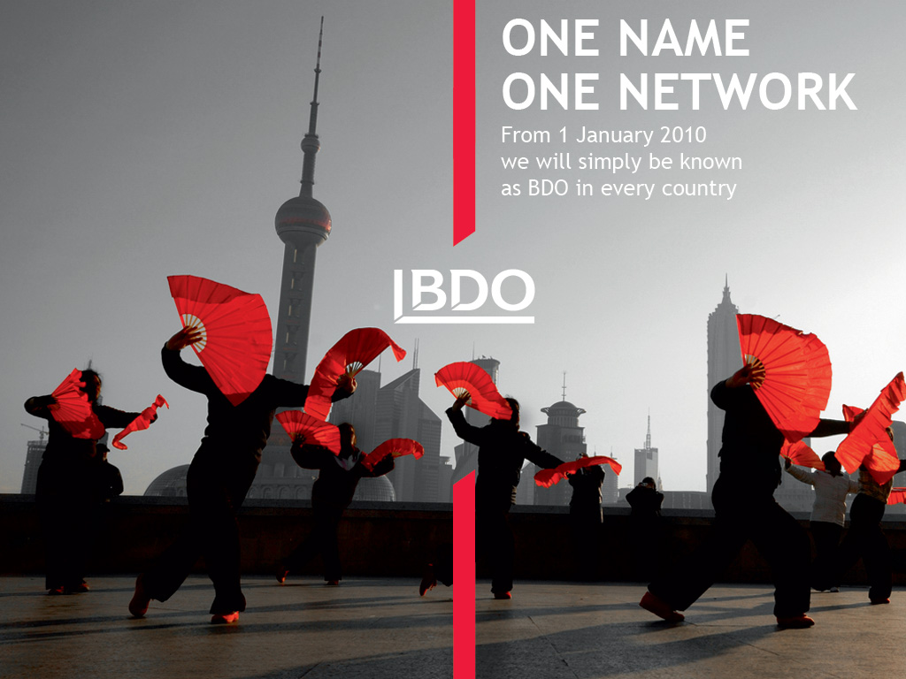
CONSISTENT BRANDING
Common identity
  In 2009, BDO adopted a single global trading name and a shared approach to naming

Slide 40
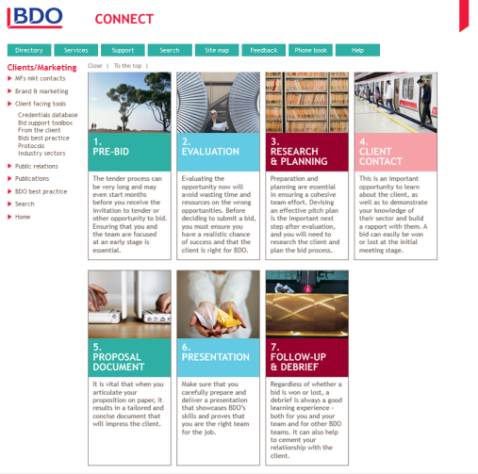
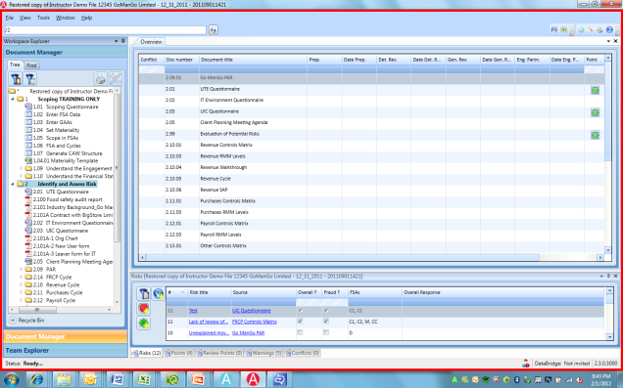
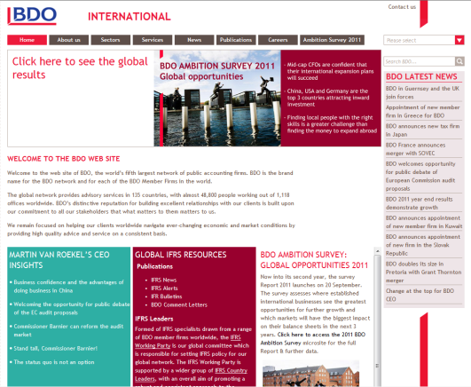
CONSISTENT BRANDING
Common identity
  This ONE NETWORK approach continues in 2012:
    Implementation of a shared market position
    A uniform audit approach (Audit Process Tool - APT)
    Common tools, methodology and best practice sharing
    A consistent approach to our clients
    and our people

Slide 41

CONSISTENT BRANDING
At local level
  Service delivery is not at a global brand level
  Service delivery is provided by our local member firms
      a local face and a local reputation
  BDO distinguishes itself from larger competitors
      by taking local responsibility
      for global quality service delivery

Slide 42
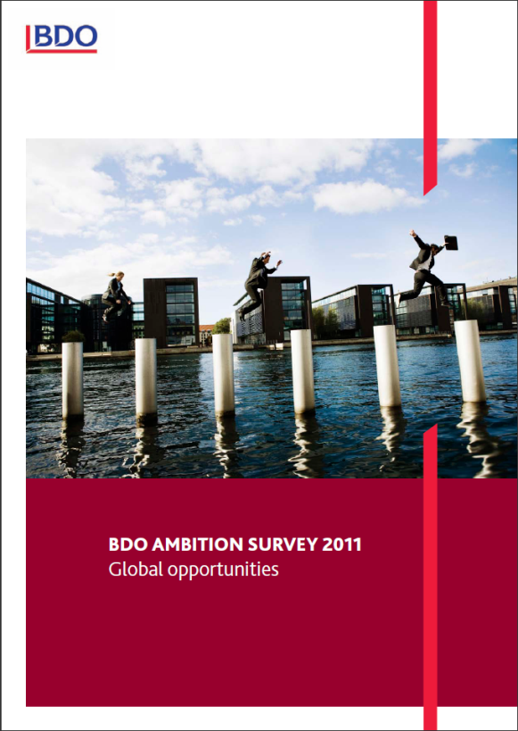
DEVELOPING OUR BRAND
Becoming known
  Promoting BDO brand through
      coordinated PR activity
      thought leadership
      engagement in industry level debates
      at global and national level
  Client recommendations

Slide 43
DEVELOPING OUR BRAND
An aligned brand worldwide
A uniform representation of the brand
      one visual identity across the world
      same tone of voice in all our communications
      similar language “what matters to you, matters to us”
  Every point of contact with our clients is recognisably BDO, everywhere in the world:
      our publications
      our promotional activity
      our web sites
Notes:
Our web sites demonstrate the consistent application of our visual identity, whilst still allowing flexibility and individuality
.

Slide 44
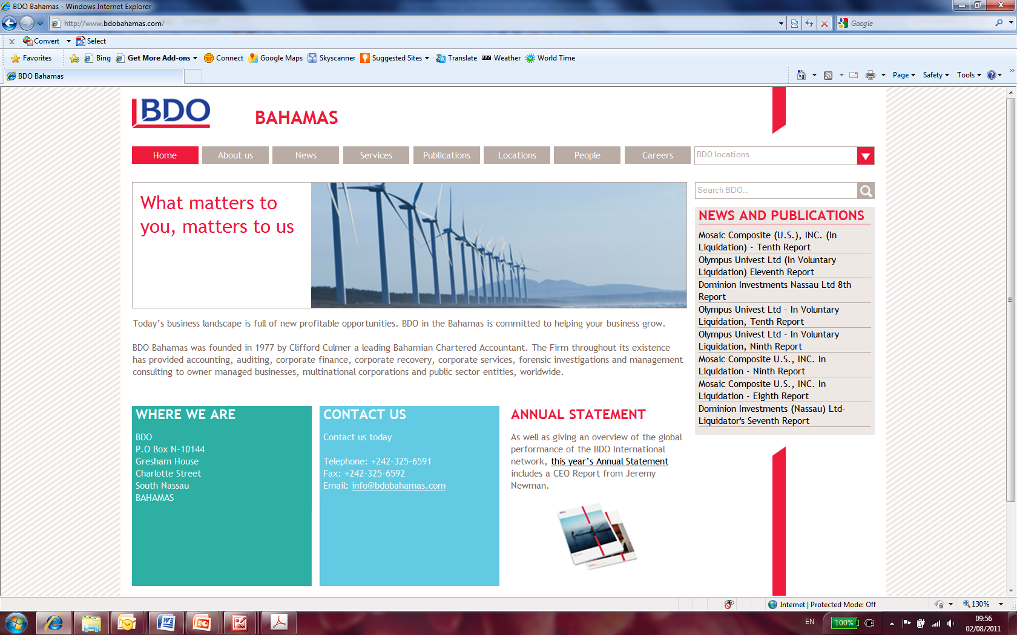

Slide 45
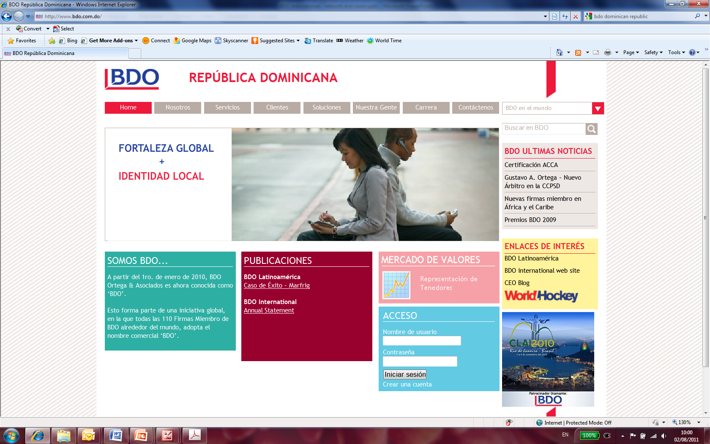

Slide 46
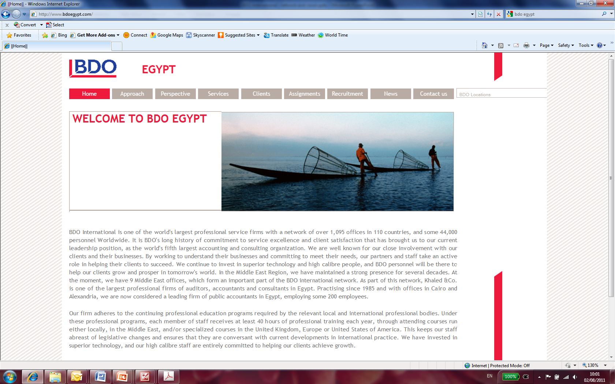

Slide 47
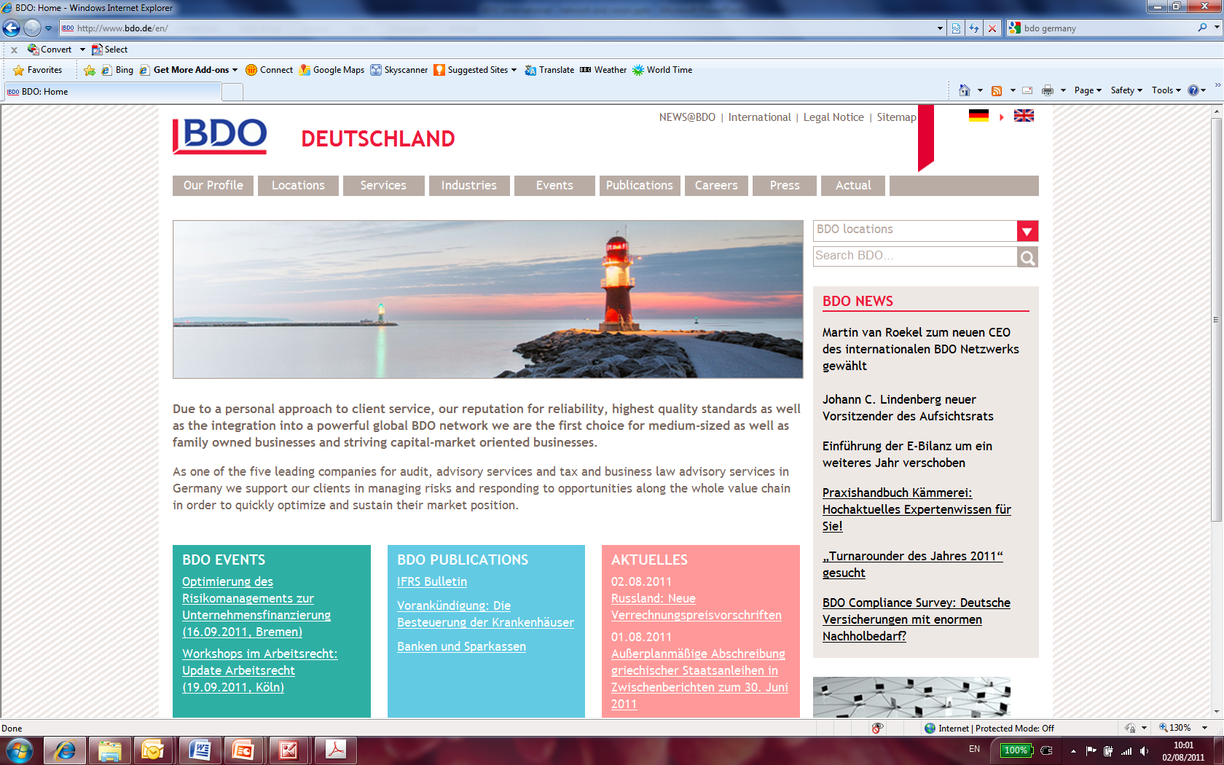

Slide 48
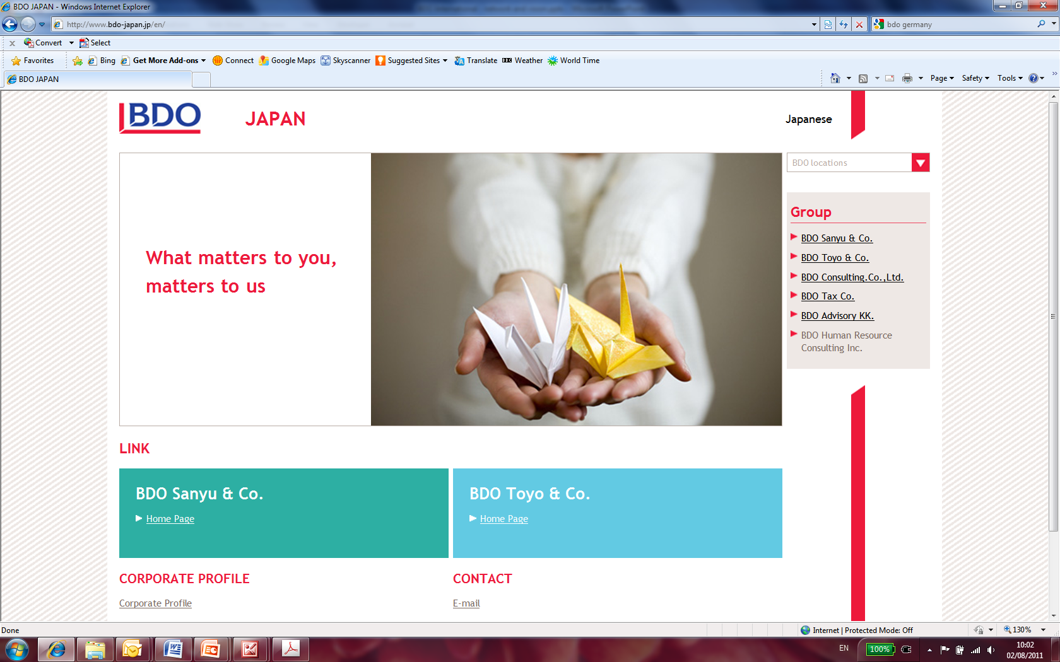

Slide 49
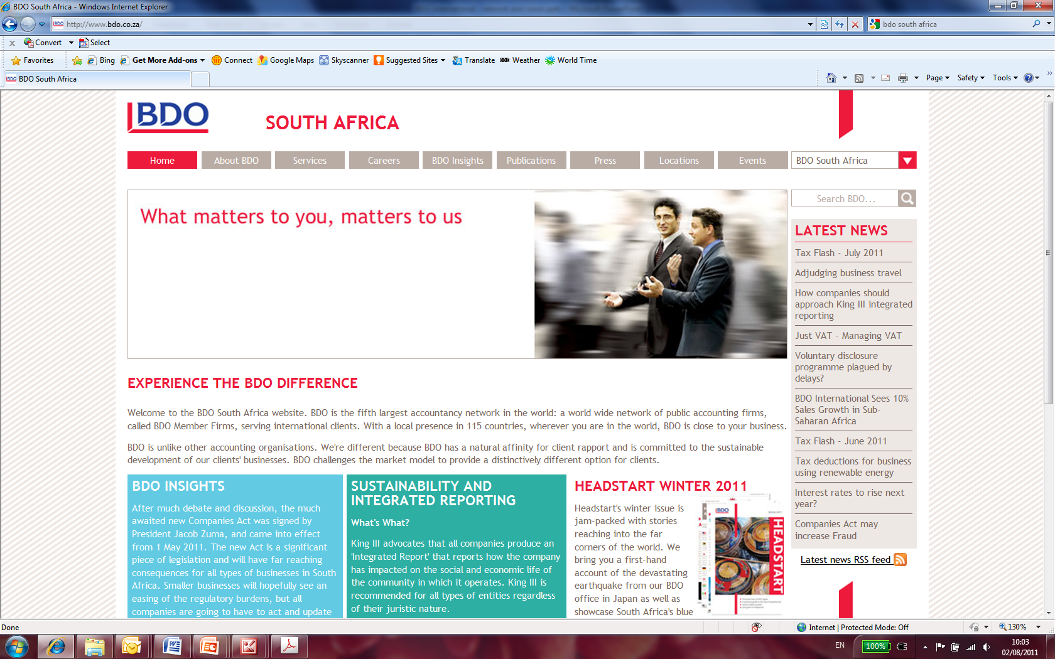

Slide 50
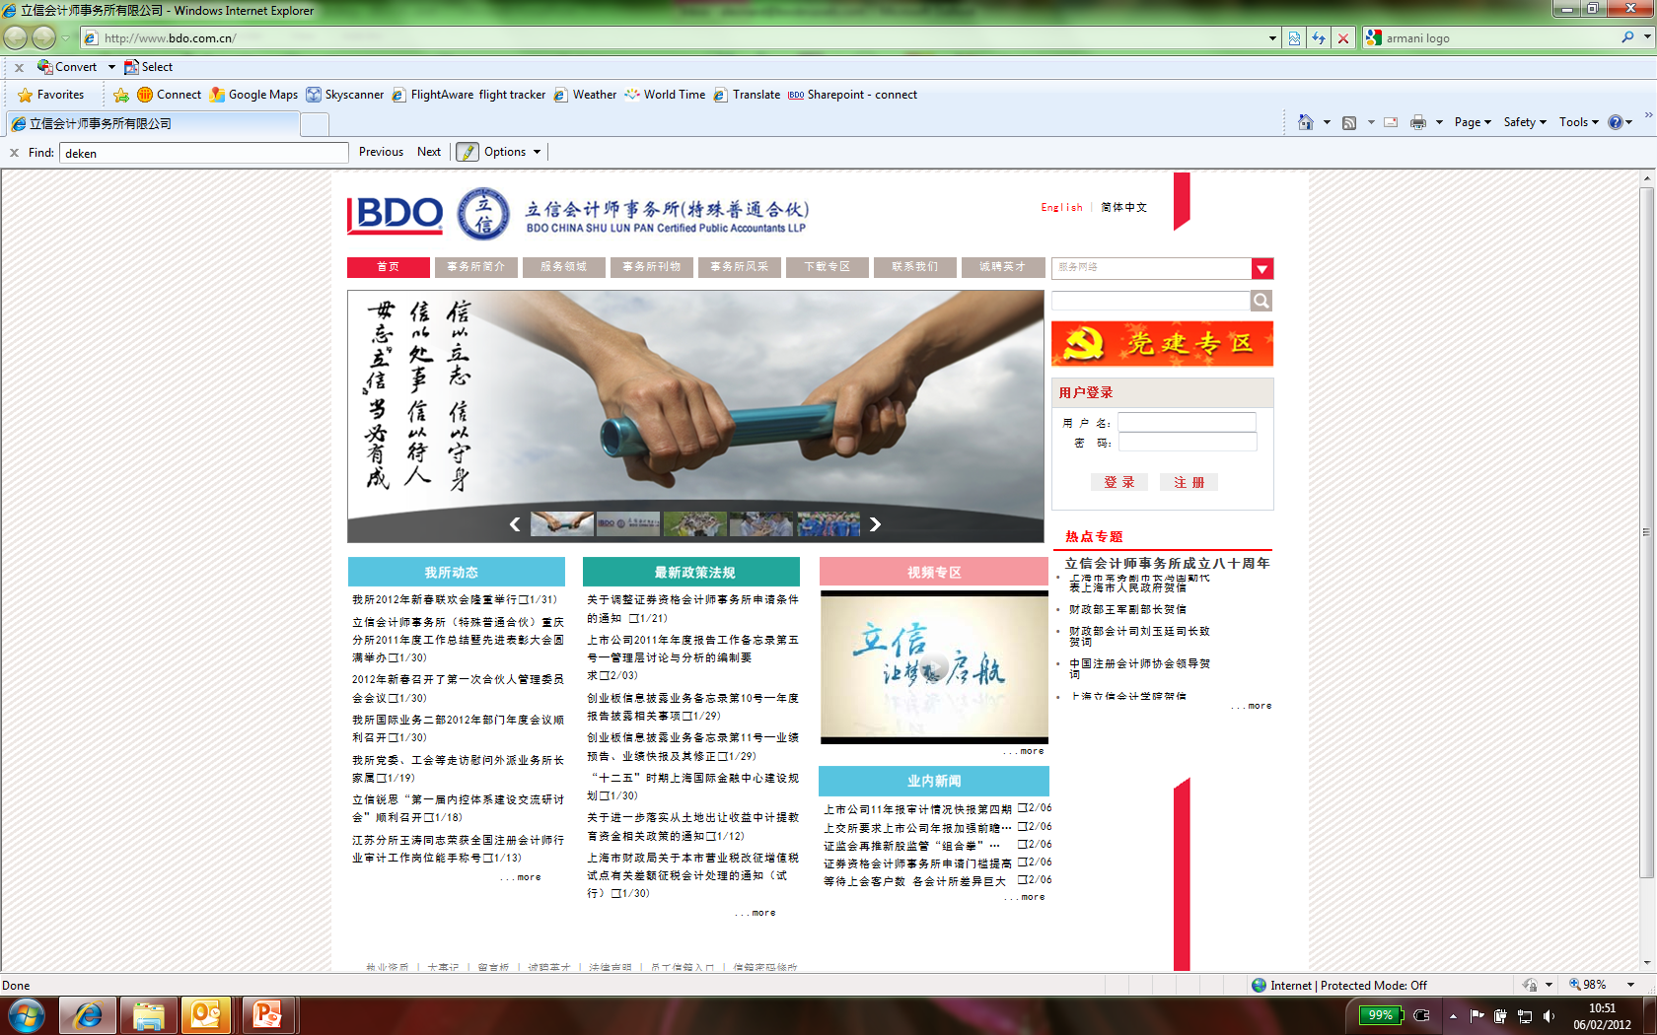

Slide 51
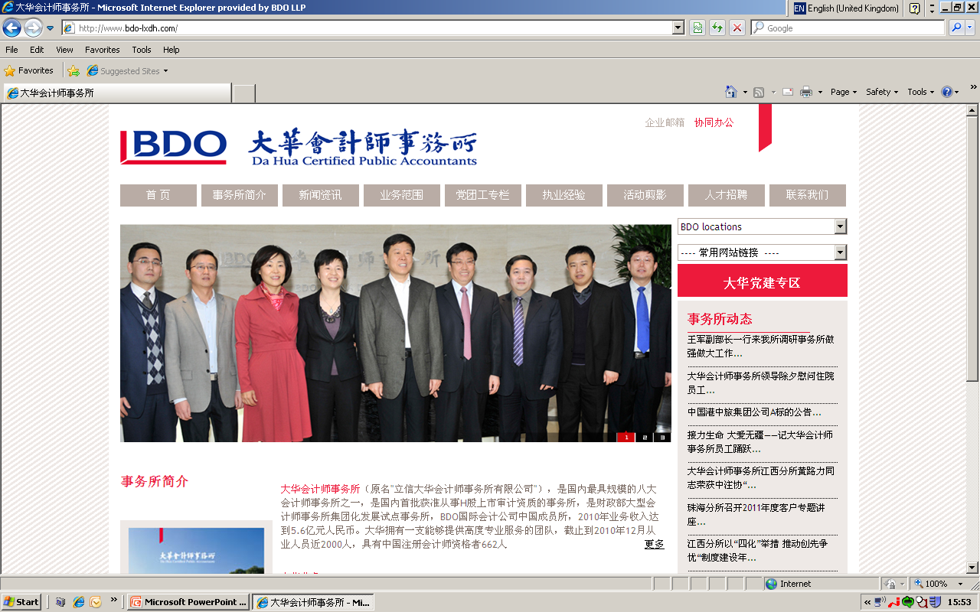

Slide 52
HELPING OUR FIRMS ALIGN WITH
THE BDO BRAND

Slide 53

ONE NETWORK
Consistent client service
Global tools to help win and service work,
e.g. Bid support toolbox, Audit Process Tool
Global and regional heads of services
Centres of Excellence
Develop service standards

Slide 54
ONE NETWORK
BDO Brand Centre
All our brand assets are available to all our member firms
      Logo files
      Artwork
      MS Office templates
      Best practice sharing
  Guidelines are provided for each asset
  Each member firm has a trained brand centre manager

Slide 55

ONE NETWORK
Brand education
We incorporate our brand positioning into our learning and development programmes
Conferences help networking and promote a consistent message
HR Framework
Regional support

Slide 56
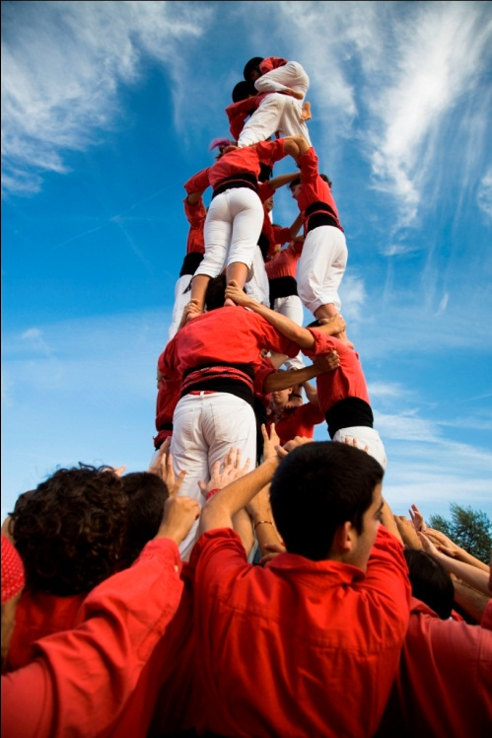
ONE NETWORK
Our people
Our global culture is built on respect and awareness of local cultural needs and differences:
Our people bring our brand to life
Recruiting, developing and retaining the right people is key
Our people have the skills and confidence to deliver a consistently exceptional level of service

Slide 57
ONE NETWORK
Everybody’s responsibility
“ We are what we repeatedly do.
Excellence, therefore, is not an act but a habit. ”
Aristotle
“ If you create an act, you create a habit
If you create a habit, you create a character
If you create a character, you create a destiny. ”
Andre Maurois

Slide 58
THE IMPORTANCE OF A BRAND AND BRANDING
Thank you
Martin van Roekel
February 2012

